Slide 1




Computational Statistics and Machine Learning Techniques for Effective Decision Making on Student’s Employment for Real-Time
Under the topic of : Machine Learning in Education Technology
One-Week Interdisciplinary FDP On:
Emerging Trends in Computational Intelligence (Machine Based Learning)
Akal University, Talwandi Sabo
Dr. Deepak Kumar
Associate Professor
Department of Computer Science & Engineering
Apex Institute of Technology, Chandigarh University
Mohali(Punjab)
Dr.D.K.Mehta81@gmail.com
Citation: Kumar, D.; Verma, C.;Singh, P.K.; Raboaca, M.S.; Felseghi, R.-A.; Ghafoor, K.Z. Computational Statistics and Machine Learning Techniques for Effective Decision Making on Student’s Employment for Real-Time. Mathematics 2021, 9, 1166. https://doi.org/10.3390/math9111166

Slide 2

Dr. Deepak Kumar
Associate Professor
Deptt. Of CSE
AIT CSE, CU Mohali
Education:
Ph.D. in Computer Science
M.Tech.(CSE)
MCA
B.Sc. Internet Science
Experience:
Associate Professor, AIT CSE, Chandigarh University, Mohali (PB)
Associate Professor, Guru Kashi University, Bathinda (PB)
Former Director-Principal, Bharat Group of College, Sardulgarh, Mansa (PB)
Assistant Professor, JCD Memorial College Sirsa (Hry)
Assistant Professor, Shah Satnam ji Boys College, Sirsa (Hry.)
Research
WOS + Scopus: 3 Journals
Scopus: 8 conferences
Springer Book Chapters : 2
I, Dr. Deepak Mehta is an Associate Professor in Chandigarh University, Mohali and, had also been an ex-Director/Principal cum Associate Professor in Bharat Group of Colleges Sardulgarh (Mansa)-Punjab. I have 15 years’ experience of teaching. He has taught in various colleges like SSJ Boys College Sirsa, DN College Hisar, JCD Vidyapeeth Sirsa, BGC Sardulgarh and Guru Kashi University, Talwandi Sabo-Bathinda. I have done his Ph.D. in computer science and have earned his M.Tech (IT) from MMU Mulllana (Ambala) and MCA from KUK. I have performed detailed business and data analysis. I have experience of supervision and coach programmes staff and manage performance. I have cleared National Eligibility Test (NET) in 2012. I have trained various machine learning scholar and many students have passed UGC-NET under his guidance in his college tenure. I have published various research papers indexed in scopus and wos and attended different international and national conferences and have copyrights. I have convened two International and 1 National conference. I was also advisory board member of UG Board, CDLU Sirsa from 2014 to 2017.

Slide 3
Table of Contents
Abstract of Study
Introduction
Problem Statement
Research Design & Methodology
Objectives
Dataset Description
Data Preprocessing
Experiment and Results
Discussion

Slide 4

Abstract
The present study accentuated a hybrid approach to evaluate the impact, association and discrepancies of demographic characteristics on a student’s Job placement.
Extracted several significant academic features that determine the Master of Business Administration (MBA) student placement and confirm the placed gender.
Recommended a novel futuristic roadmap for students, parents, guardians, institutions, and companies to benefit at a certain level.
The first five experiments were conducted with deep statistical computations, and the last two experiments were performed with supervised machine learning approaches.
A statistical t-test performed at 0.05 significance level.
Chi2 test also taken for verifying the association.
Support vector machine, Random Forest and other supervised learning algorithms are used here

Slide 5

Nowadays, data are available in a productive manner in educational organizations’ databases but are never utilized at a significant level.
It can become beneficial to the institutes in improving the quality of training according to industry requirements.
Any college or university deems it a success when their students get placed in well-settled companies or organizations.
In this pandemic, when there is cutthroat competition and fewer jobs, one wants to know which skills or characteristics matter to companies.
This can be explored by analyzing the previous years’ placement datasets.
Moreover, machine learning is one of these techniques, which can be used in predicting the skills and other requirements that are needed for desired industry recruiters.
In prestigious intuitions, placement analysis and forecasting systems always help assess student performance and secure a suitable placement quickly

Slide 6

The disproportionate placement numbers are always reflected in college placement drives. It is often assumed among recruiters that female students might score higher in any competitive test and may be helpful in their academic endeavors [2].
The present study is also interested in realizing all the factors that lead to students’ success (or failure) at the master’s level in getting a placement and assessing the impact of gender on the placement test.

Slide 7
Used secondary data on campus placement from the Kaggle website[3].
The study has been done to analyze the impact of gender on students’ offered salary in campus placement.
For this study, we have taken an independent t-test to compare the two groups to the offered salary.
To find the significant difference between two unrelated groups, the independent t-test is a better approach.
Explored the significant association between specialization, degree-stream and placement status.
To explore a significant correlation between two nominal variables, a chi-square (χ2) test of independence (non-parametric) is appropriate.

Slide 8
Used contemporary predictive algorithms to identify the placement status and the gender of placed students in campus placement.
For this, we used RF, XGBoost (XGB), SVM, and Logistic regression (LR) classification algorithms.
We also used the intrinsic feature ranking algorithm of RF and XGB to extract essential features on which prediction is assessed.
RF can be used to find the best combination of features, and it will not allow over-fitting trees in the model if there are more decision trees.
SVM is popular due to the linear separable feature in high dimensional space (many features).
The XGB works well with datasets containing numerical and categorical features and data with only numerical features.

Slide 9
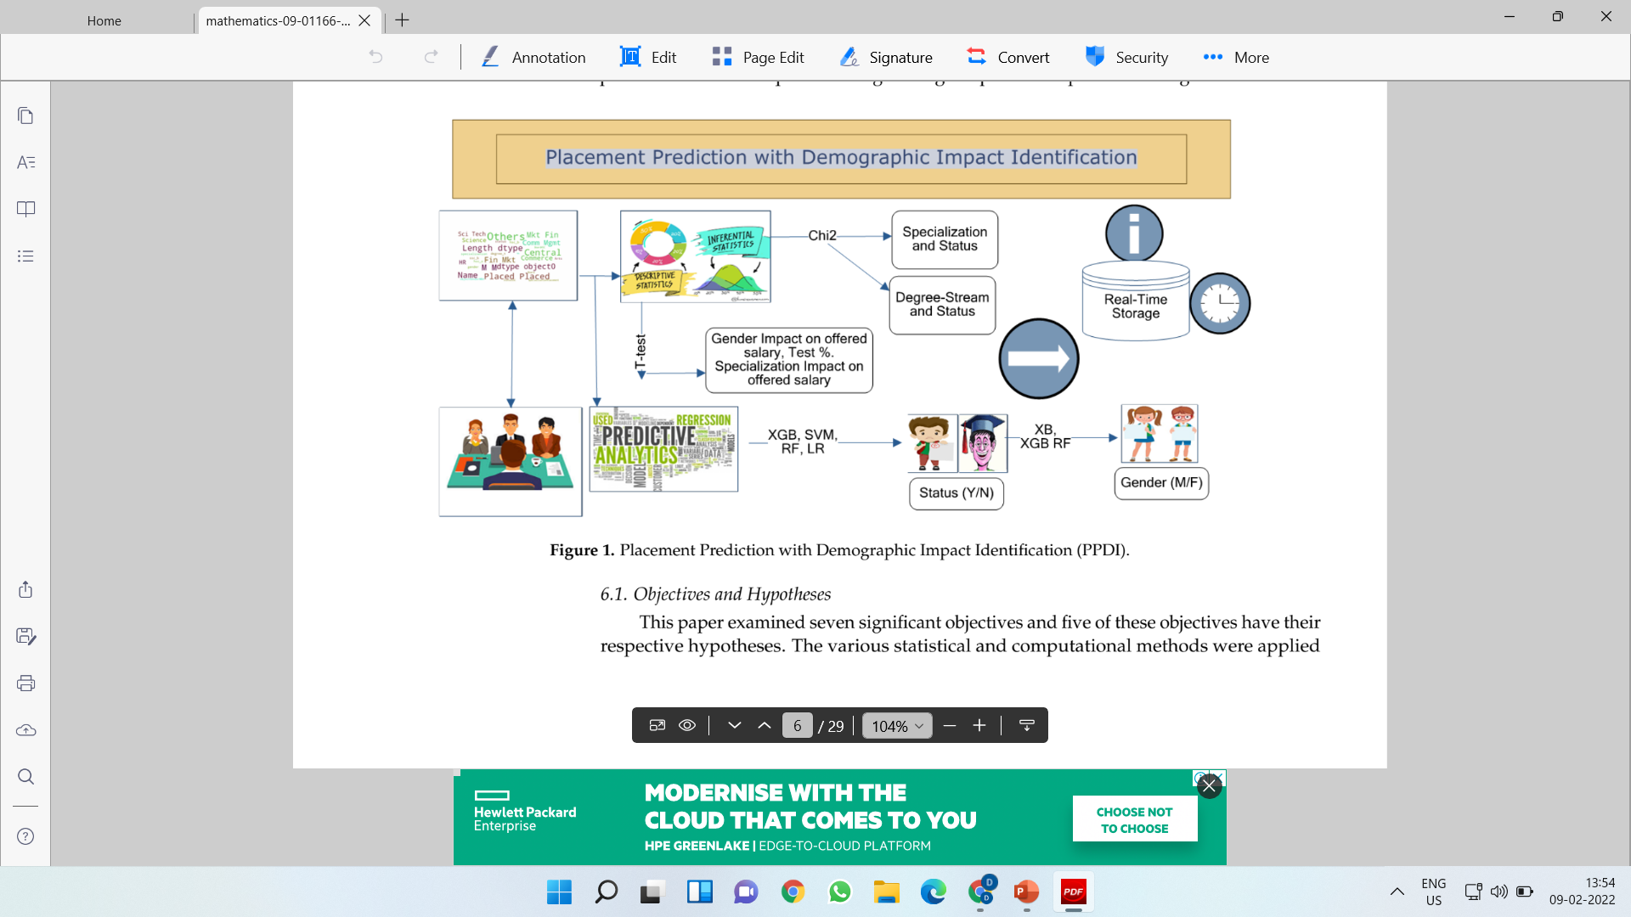

Slide 10

A study was conducted on the South Asian Universities dataset in 2014–2016 with the help of statistical tools. It was found that the used statistical methods improved the placement process accuracy with good glaring performance. Overall, the academic rate as a determinant in predicting placement played a better role[4].
A technical college’s placement data was analyzed with academicians predicting which engineering branch or stream would be full with admission accuracy (80%) and with a random forest classifier [6]
Moreover, the study also found that placed students’ offered salary was predicted in two phases of the dataset with the k-nearest neighbor (94.5%) and XGB regression.
One of the studies [8] also favored the RF model for predicting student placement (99.9%). It also extracted the UG degree percentage (p < 0.05) as an important core feature in obtaining a dream placement.
As observed, most cited studies preferred the RF model for prediction due to its ensemble learning approach

Slide 11

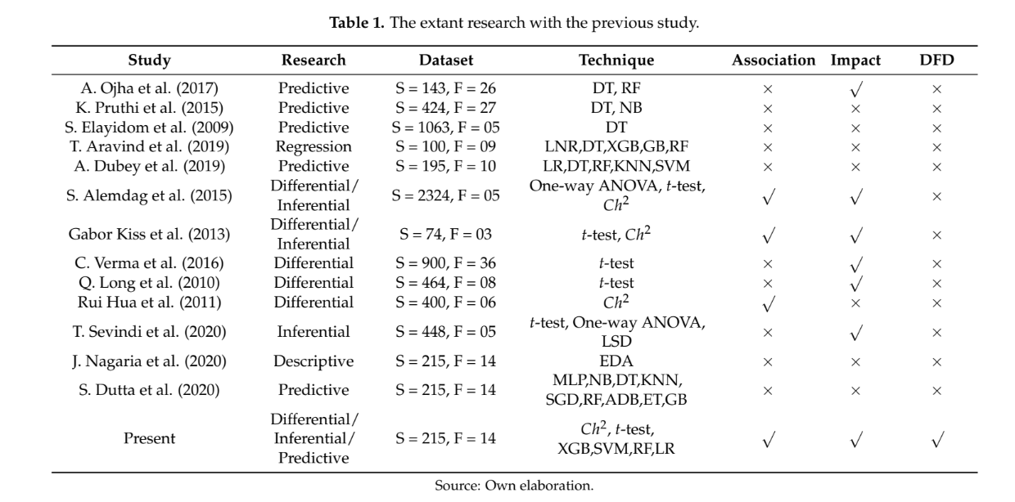

Slide 12
Table 1 displays the extant research that used predictive and differential study on placement or related datasets to forecast employability chances and to assess the impact of different variables.
It also contrasts and compares all related studies with the present research scheme.
A. Ojha et al. (2017) utilized the Decision Tree (DT) and Random Forest (RF) model and predicted placement chances for a student with his academic background.
Moreover, the result from K.Pruthi et al. (2015) used forecasting employability for a student in campus placement with Naïve Bayes (NB).
T.Arvind et al. (2019) used regression for forecasting placed student salary with Linear Regression (LNR), Extreme Gradient Boosting (XGB), Gradient Boosting (GB), and Random Forest (RF) regression.
Gabor Kiss et al. (2013) and C.Verma (2016) assessed the significant impact of gender on different variables.
The associativity also verified two nominal variables, English language and gender (T.Sevindi et al. (2020)) and proved the relationship exists among them.
The present study used differential, inferential and predictive analysis with Determinant Feature Detection (DFD) research on a placement dataset and tried to assess the impact of gender and specialty in masters on placement chances, and the offered salary.
It also tried to forecast student employability and placement gender in campus placement using supervised machine learning algorithms such as Support Vector Machine (SVM), Logistic Regression (LR), RF and XGB.

Slide 13

Earlier work used either predictive or statistical analyses of the data patterns belonging to student placements.
Using identical samples, researchers did not explore the impact of gender on specialization towards students’ offered salary in campus placement.
Previous studies did not even identify the placement status or the gender of placed students [18,19].
Other literature encouraged us to fill the research gap by developing hybrid automated models.
It is found that there is a lack of prominent issues in the existing studies, such as impact of salary of placed student on the course specialization and gender, effect of placement test percentage on gender, association between placement status and course specialization and stream of a degree program, and placement identification with gender and status.
However, the present study has overcome the these issues with significant results.

Slide 14

Objectives and Hypotheses
To discover the difference between male and female students towards offered salaries.
Hypothesis 01 (H01): No significant difference between male and female students towards the offered salary.
Hypothesis 1A (H1A): A significant difference between male and female students towards the offered salary.
To discover the difference between MBA Specialization (Mkt&Fin and Mkt&HR) towards offered salaries.
Hypothesis 02 (H02): No Significant difference between Mkt&Fin and Mkt&HR towards the offered salary.
Hypothesis 2A (H2A): A Significant difference between Mkt&Fin and Mkt&HR towards the offered salary.

Slide 15
To explore a significant difference between male and female students towards placement test percentage.
Hypothesis 03 (H03): No significant difference between male and female students towards placement test percentage.
Hypothesis 3A (H3A): A significant difference between male and female students towards placement test percentage.
To discover the association between MBA specialization and placement status.
Hypothesis 04 (H04): No association between Mkt&Fin and Mkt&HR specialization towards placement status.
Hypothesis 4A (H4A): A significant association between Mkt&Fin and Mkt&HR towards placement status.

Slide 16
To discover the association between degree stream (Sci& Tech, Comm& Mgmt and Others) and placement status.
Hypothesis 05 (H05): No association between the stream of degree and placement status.
Hypothesis 5A (H5A): A significant association between the stream of degree and placement status.
To predict the placement status of the student based on significant features.
To predict gender placement based on significant features.

Slide 17

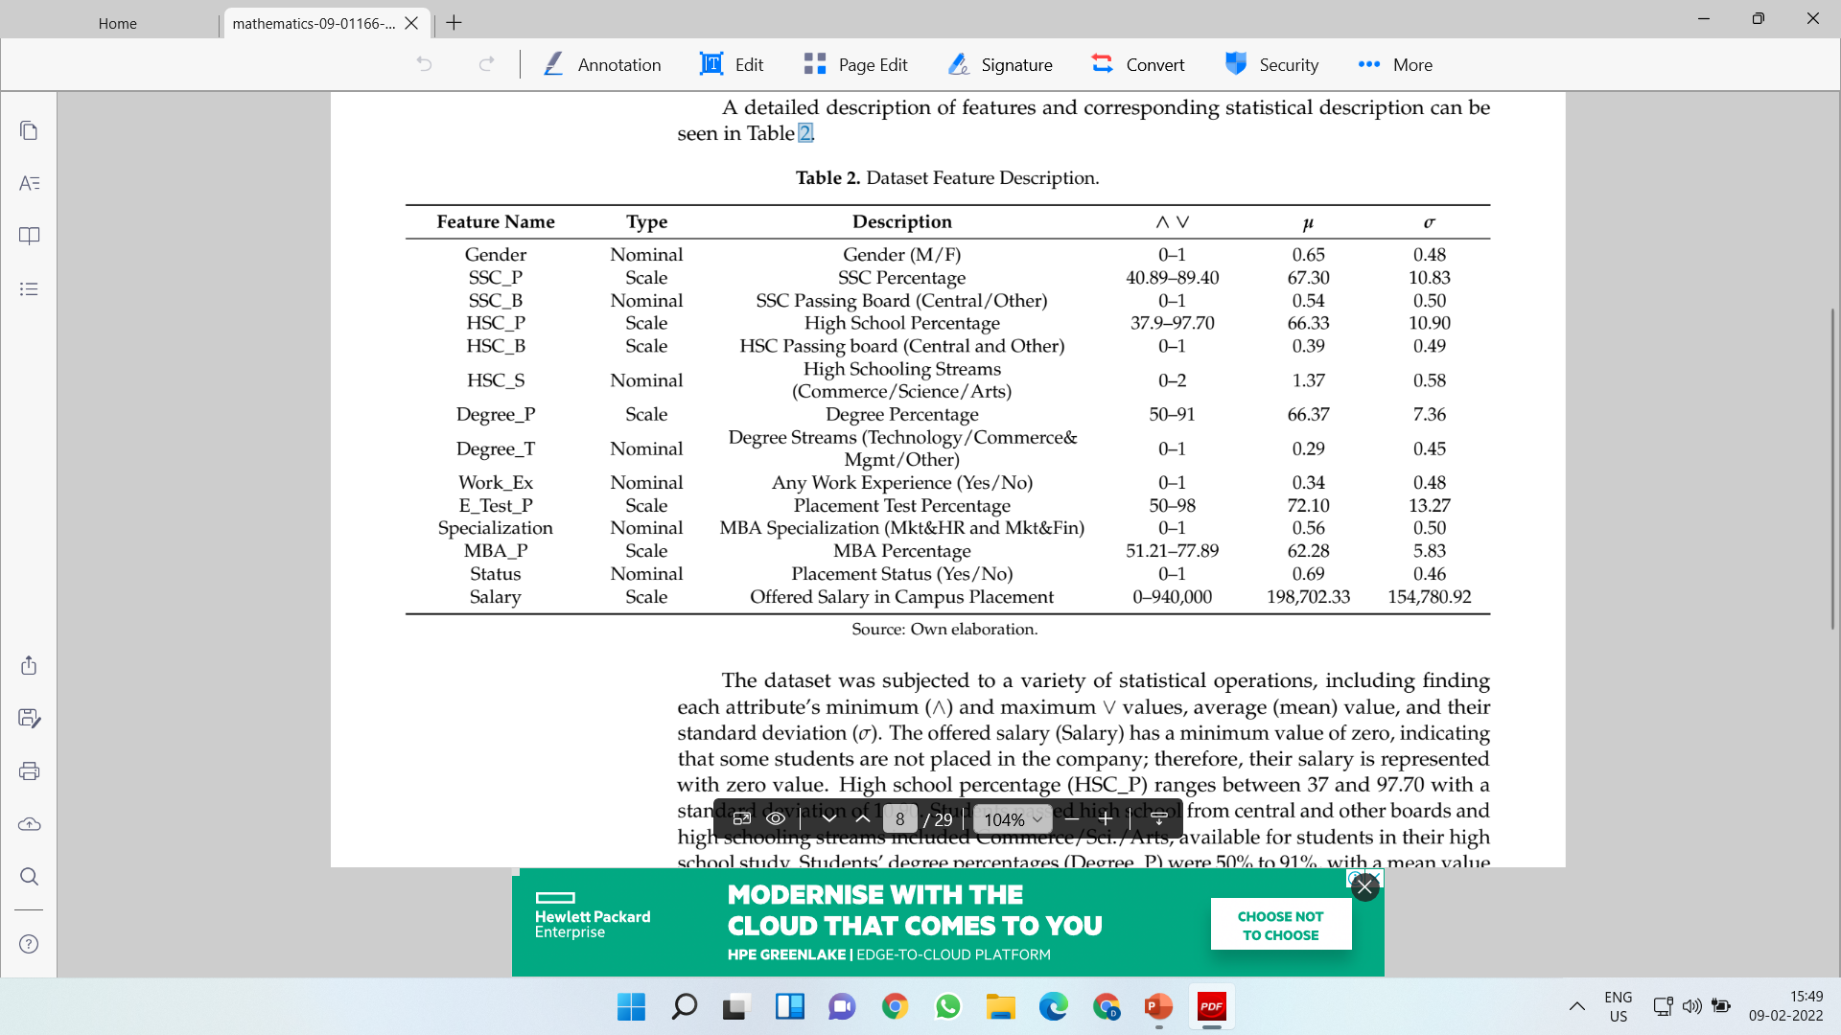
Dataset Description
The data set includes 215 observations with 14 features (Nominal-8, Scale-6).
Acceptable reliability of the used instrument is 0.61 given y the Cronbach’s alpha test.

Slide 18
Descriptive Analysis
There are 139 samples of Male and 76 samples of Female candidates’ offered salaries in the given dataset.
There are also students of Mkt&Fin and Mkt&HR of MBA specialization streams consisting of 120 and 95 observations of the offered salaries.
From the demographic data, male students are achieving more placements than female students, and the scenario is the same for unplaced status.
Secondly, the Secondary Education schooling board (other and central) did not make any difference as compared to the higher secondary board where education from the other board has an impact on placement status.
This can be observed that more students took Comm&Mgmt and Sci&Tech as compares to arts students in higher secondary subjects.
The majority of Comm&Mgmt degree students can also be observed in a placement role in a 2:1 ratio of comm to science.

Slide 19
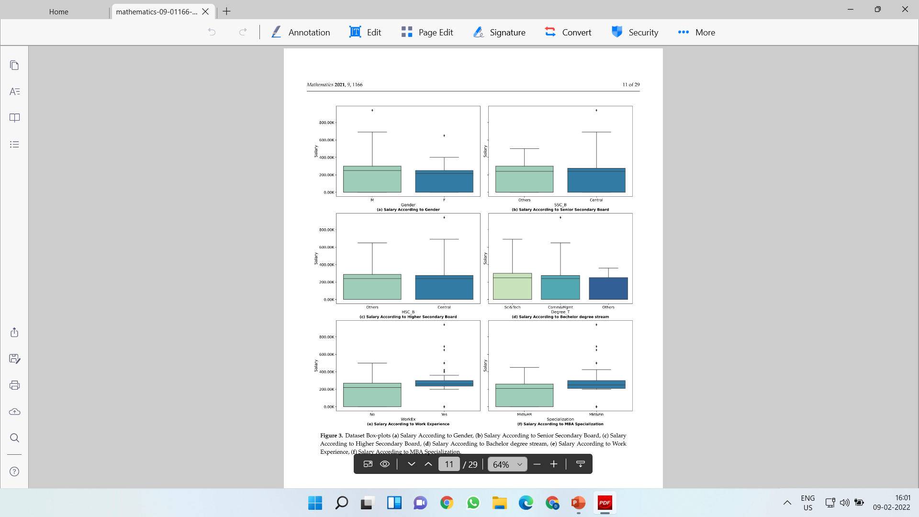

Slide 20
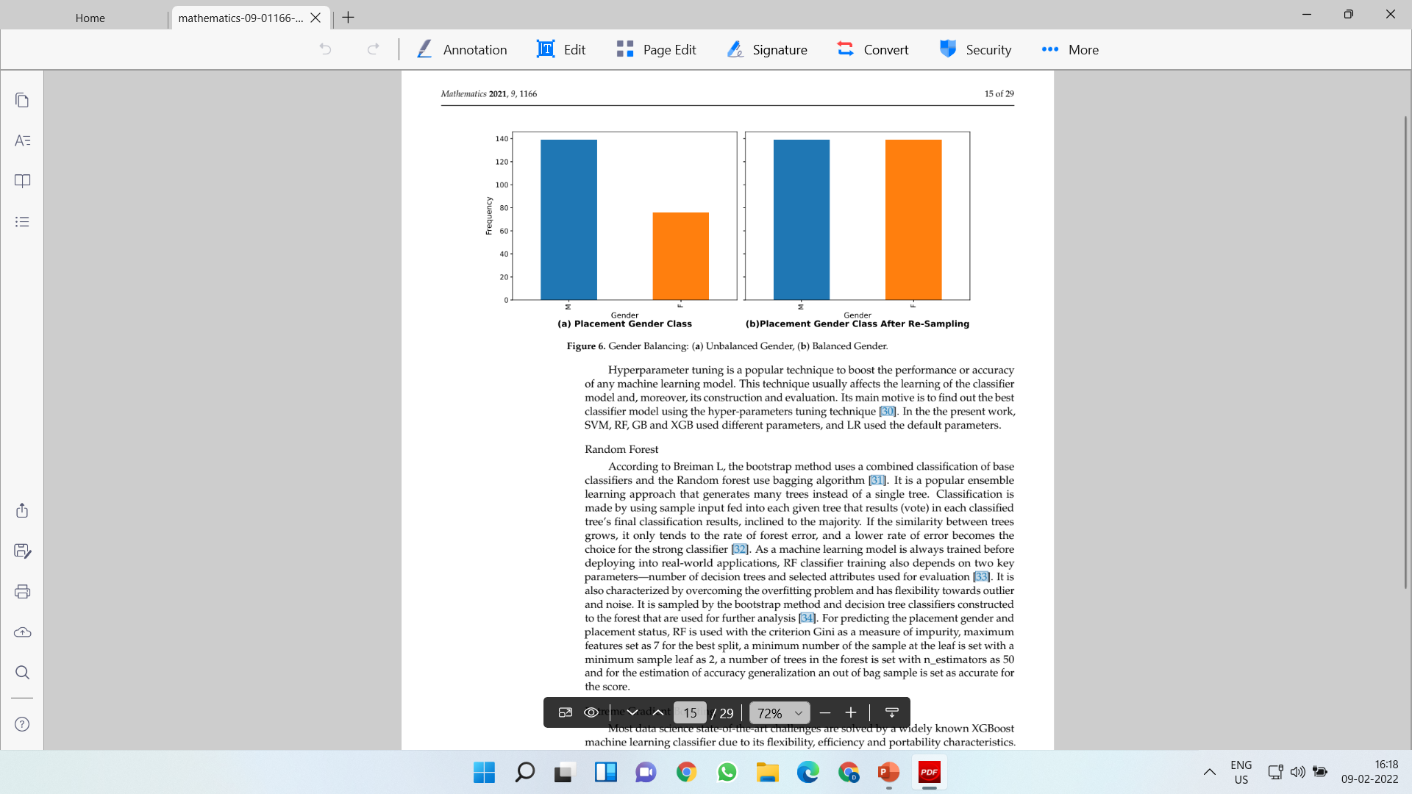
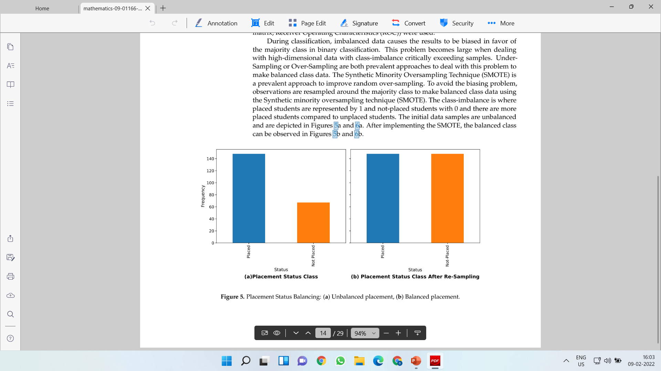
Challenge During classification
During classification, imbalanced data causes the results to be biased in favor of the majority class in binary classification.
This problem becomes large when dealing with high-dimensional data with class-imbalance critically exceeding samples.

Slide 21
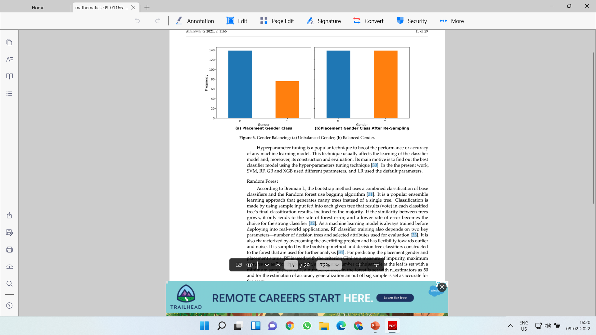
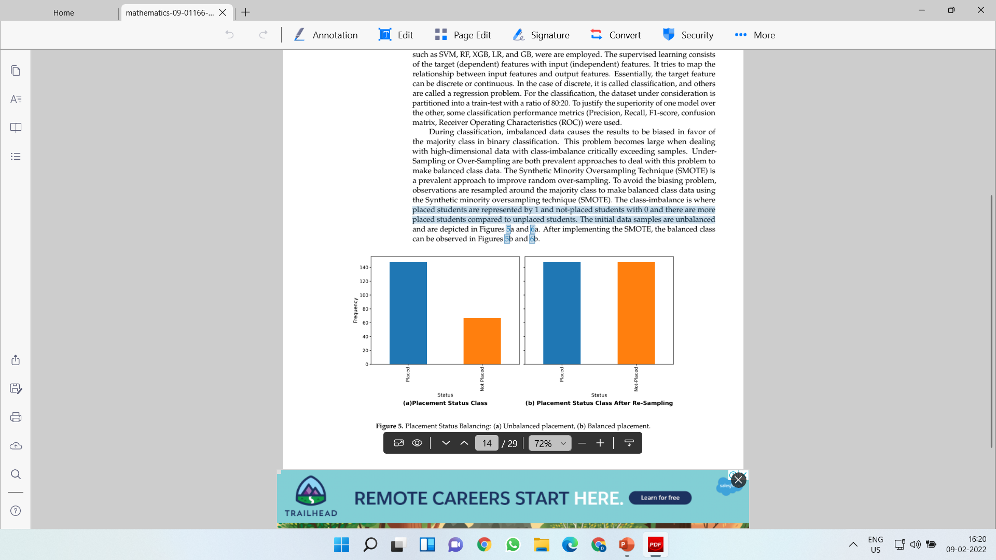
SMOTE
The Synthetic Minority Oversampling Technique (SMOTE) is a prevalent approach to improve random over-sampling.
To avoid the biasing problem, observations are resampled around the majority class to make balanced class data using the Synthetic minority oversampling technique (SMOTE).

Slide 22
Experiment-1
This experiment explores the impact of Students’ gender on their offered salaries.
The student’s t-test at a confidence interval of 95% (α = 0.05) was used to test the first null hypothesis “H01”.
It explored the impact of gender on salary offered to the students.
Gender is an independent variable, and the offered salary is considered the dependent variable.
The important assumption the t-test explored was a statistically significant difference between the Male (M) and Female (F) MBA student in terms of offered salary.

Slide 23
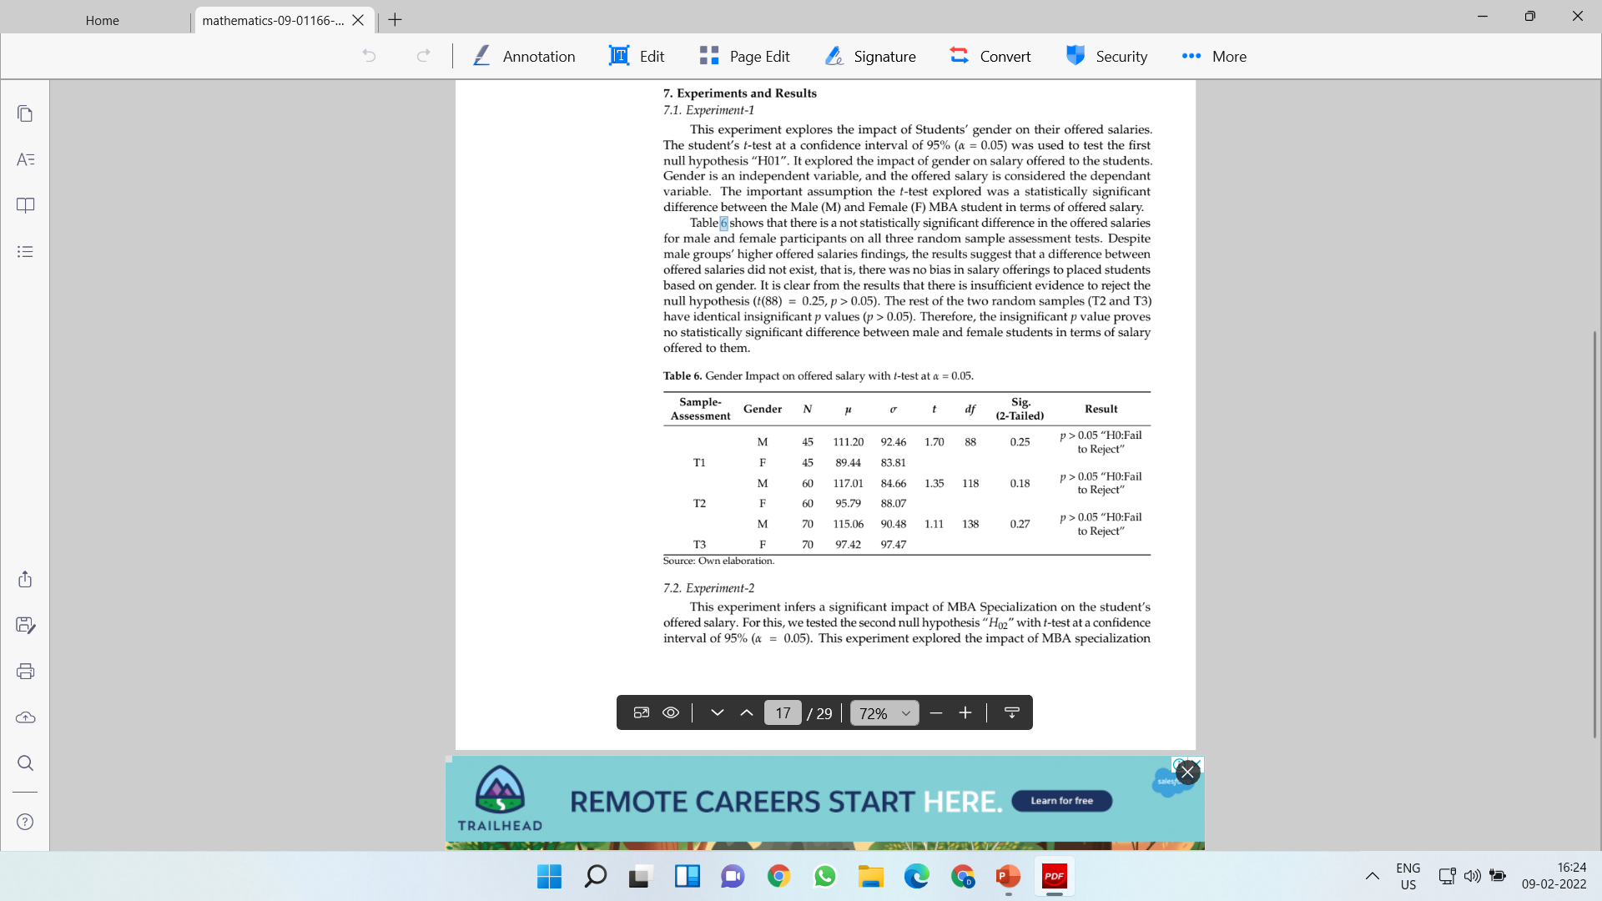
There is a not statistically significant difference in the offered salaries for male and female participants on all three random sample assessment tests.
Despite male groups’ higher offered salaries findings, the results suggest that a difference between offered salaries did not exist, that is, there was no bias in salary offerings to placed students based on gender.
It is clear from the results that there is insufficient evidence to reject the
null hypothesis (t(88) = 0.25, p > 0.05).
The rest of the two random samples (T2 and T3) have identical insignificant p values (p > 0.05). Therefore, the insignificant p value proves no statistically significant difference between male and female students in terms of salary offered to them.

Slide 24
Experiment-2
This experiment infers a significant impact of MBA Specialization on the student’s offered salary.
For this, we tested the second null hypothesis “H02” with t-test at a confidence interval of 95% (α = 0.05).
This experiment explored the impact of MBA specialization(Mkt&Fin and Mkt&HR) on the salaries offered to the students.
Here, the independent variable is Specialization, and the offered salary is a dependent variable.

Slide 25
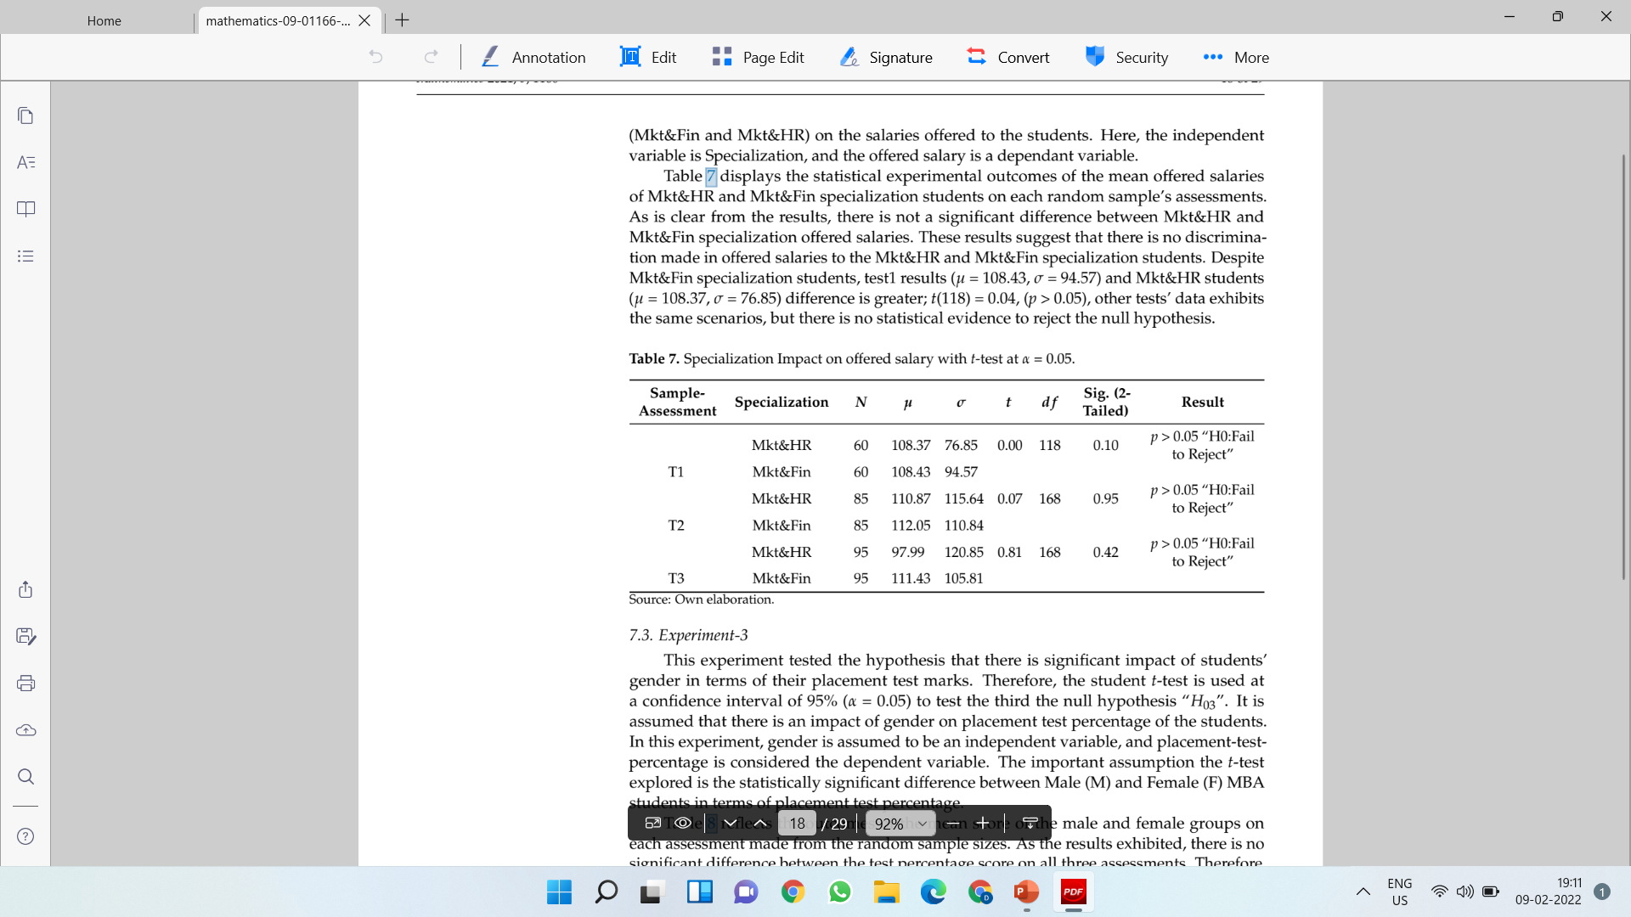
The statistical experimental outcomes of the mean offered salaries of Mkt&HR and Mkt&Fin specialization students on each random sample’s assessments.
As it is clear from the results, there is not a significant difference between Mkt&HR and
Mkt&Fin specialization on offered salaries.
These results suggest that there is no discrimination made in offered salaries to the Mkt&HR and Mkt&Fin specialization students.
Despite Mkt&Fin specialization students, test1 results (µ = 108.43, σ = 94.57) and Mkt&HR students (µ = 108.37, σ = 76.85) difference is greater; t(118) = 0.04, (p > 0.05), other tests’ data exhibits the same scenarios, ut there is no statistical evidence to reject the null hypothesis.

Slide 26
Experiment-3
This experiment tested the hypothesis that there is significant impact of students’ gender in terms of their placement test marks.
Therefore, the student t-test is used at a confidence interval of 95% (α = 0.05) to test the third the null hypothesis “H03”.
It is assumed that there is an impact of gender on placement test percentage of the students.
In this experiment, gender is assumed to be an independent variable, and placement-test percentage is considered the dependent variable.
The important assumption the t-test explored is the statistically significant difference between Male (M) and Female (F) MBA students in terms of placement test percentage.

Slide 27
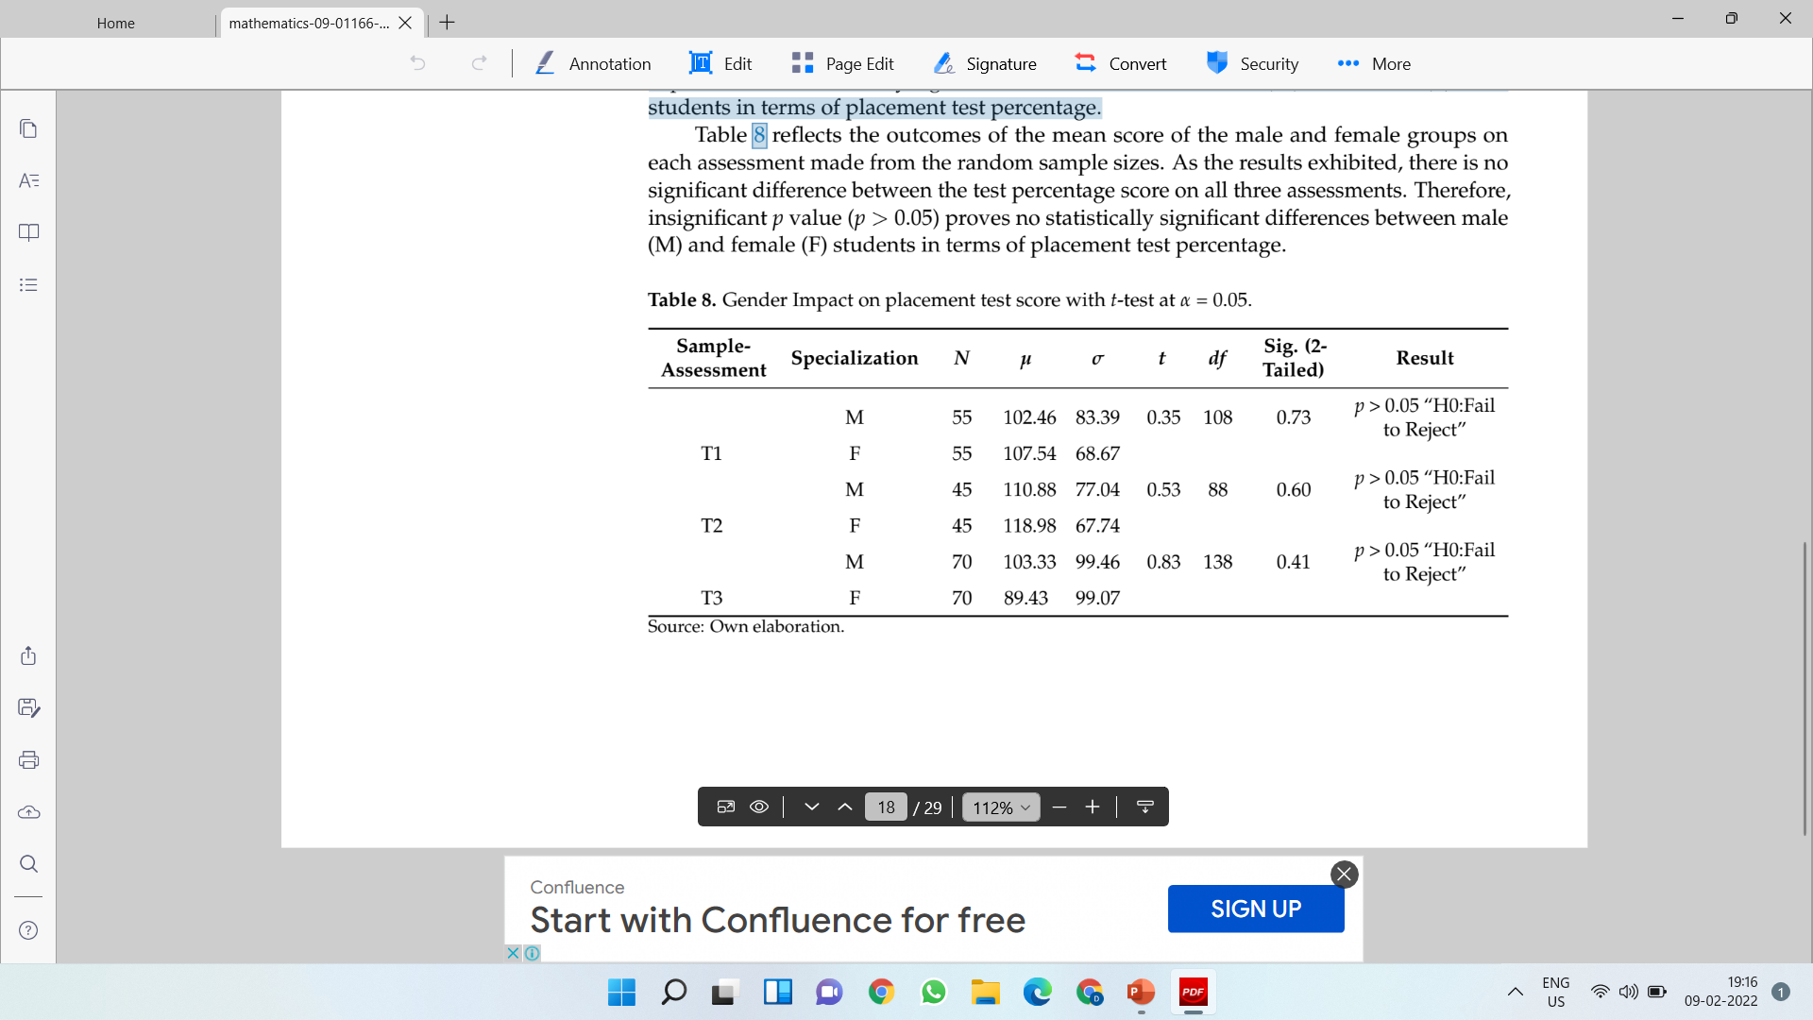
Results reflects the outcomes of the mean score of the male and female groups on each assessment made from the random sample sizes.
As the results exhibited, there is no significant difference between the test percentage score on all three assessments.
Therefore, insignificant p value (p > 0.05) proves no statistically significant differences between male (M) and female (F) students in terms of placement test percentage.

Slide 28
Experiment-4
This experiment explores the association between MBA specialization and placement status.
For this, the χ2 test is applied to determine whether there is a significant difference between MBA Specialization (Mkt&Fin, Mkt&HR) Placement-Status (Placed or Not-Placed) to test the fourth null hypothesis “H04, which assumed no significant association between MBA specialization and Placement-Test.
There is a statistically significant association found for Placement-Status χ2
(1, N = 215) = 13.51, p = 0.00.

Slide 29
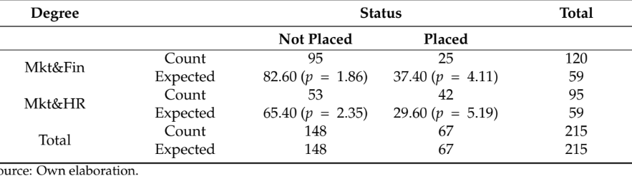
The actual association (Φ = 0.25) between specialization and status is small, calculated with the crammer’s V-Test, indicating that a weak positive relationship exists.
The reason for the weak positive relationship can be explored with a large χ2 value from the cell parenthesis being 5.19 in the “Not-Placed” column, which signifies the high value of specialization.
The larger value for this cell can be attributed to a higher number of observed values (42), while fewer high values are expected by chance (29.60).
Moreover, a greater χ2 value of 2.35 in the placement status column “Placed” reflects a relationship between the high value of specialization and the subject Mkt&Fin.

Slide 30
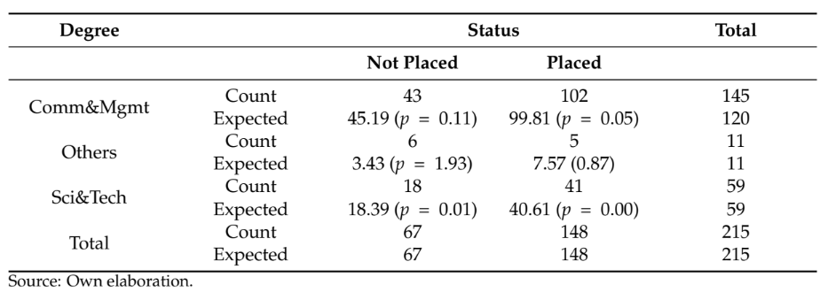
Experiment-5
This experiment is conducted to evaluate an association between the degree of stream and placement status.
To test the fifth null hypothesis “H05”, this experiment used the χ2 test to explore the association between the degree of the stream (Comm&Mgmt, Sci&Tech and Other) and placement status (Placed or Not-Placed) of students.
It is observed that there is no statistically significant association between degree of stream and placement status χ2(2,N = 215) = 2.97, p = 0.56.

Slide 31
Experiment-6
This experiment discusses the experimental results of various contemporary classification algorithms to identify the future students’ placement status with their predictive features.
At first, all used classification models, that is, RF, XGboost, SVM and LR,along with full feature space, are evaluated.
After that, three feature selection algorithms: RF feature selector, XGBoost feature Selector, SVM crucial feature selector are applied to select prominent and high variant features from feature space.
The experimental results showed that the SVM classification has been reasonably successful compared with the other classification in terms of all performance assessment measurements.
SVM achieved a precision of 90%, sensitivity of 92%, precision of 85%, and an F1 score of 88% at C = 0.01, gamma set as auto with linear kernel.
In the LR classification model, this model has displayed better performance with 88% accuracy, 84% precision, 88% recall rate, and 86% F1-score with lbfs solver and class weight set as balanced.
Similarly, the RF classifier has achieved an accuracy of 83%, 83% recall, 77% precision, and 80% F1-Score at the gini criterion with 7 maximum features, 2 minimum sample leaves with a 200 number of estimators.
XGBoost classifier has achieved 83% accuracy as similar to RF,82% precision, 75% sensitivity with 78% F1-score at learning rate set as 0.1 with 6 maximum delta step, minimum child weight set as 6.

Slide 32
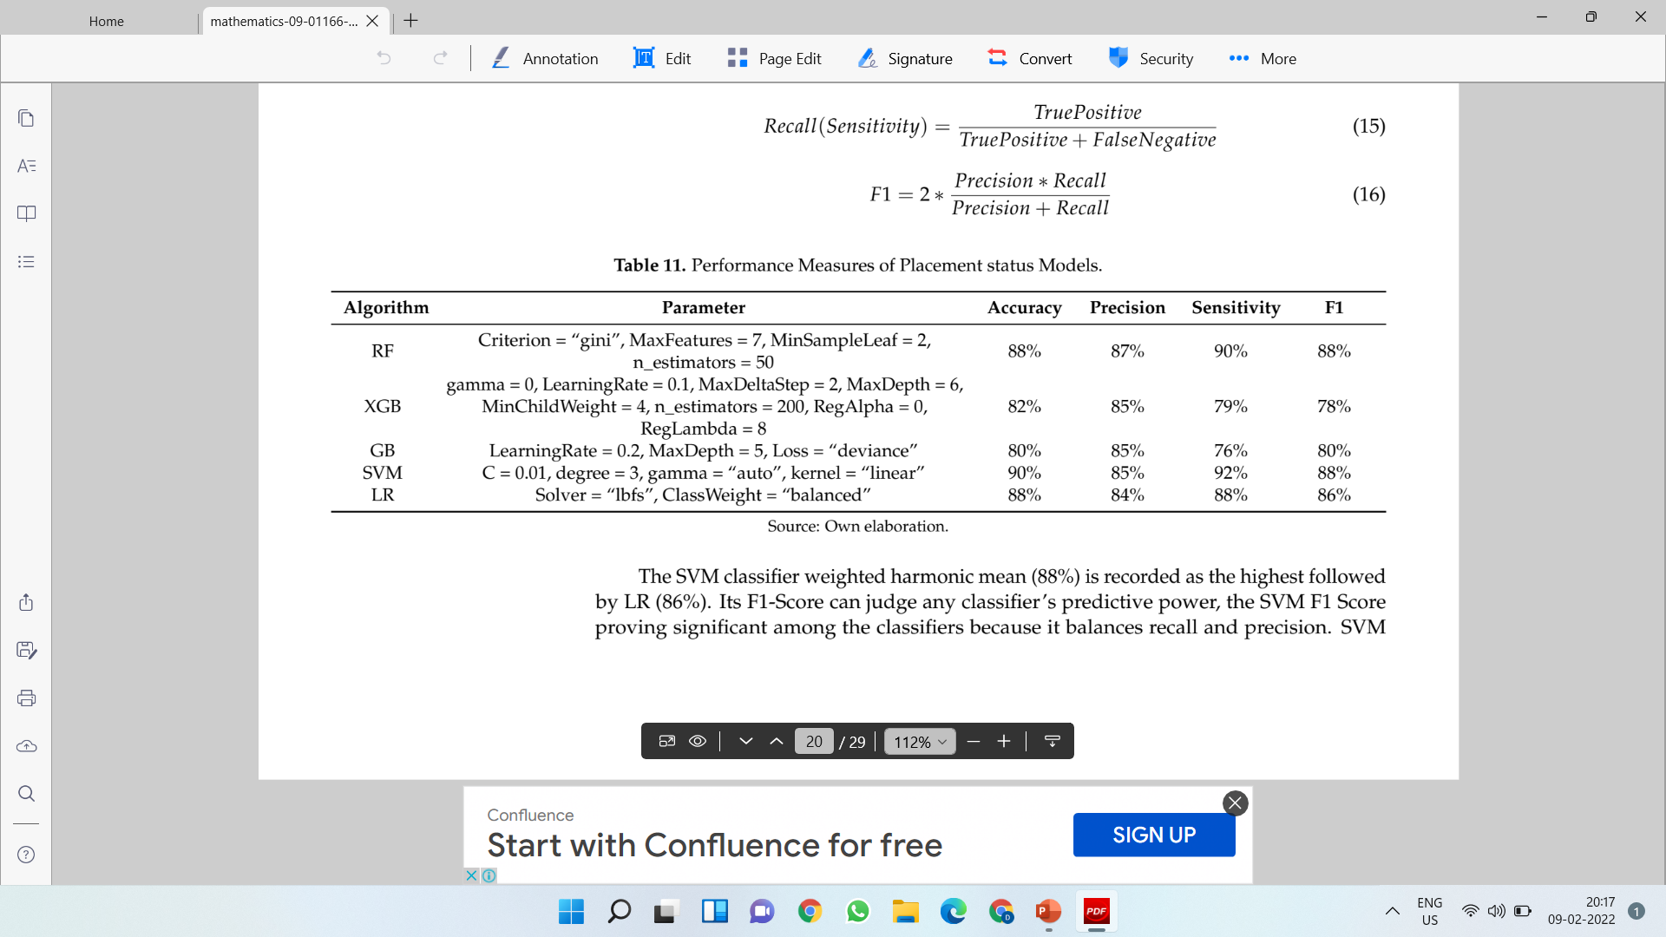

Slide 33
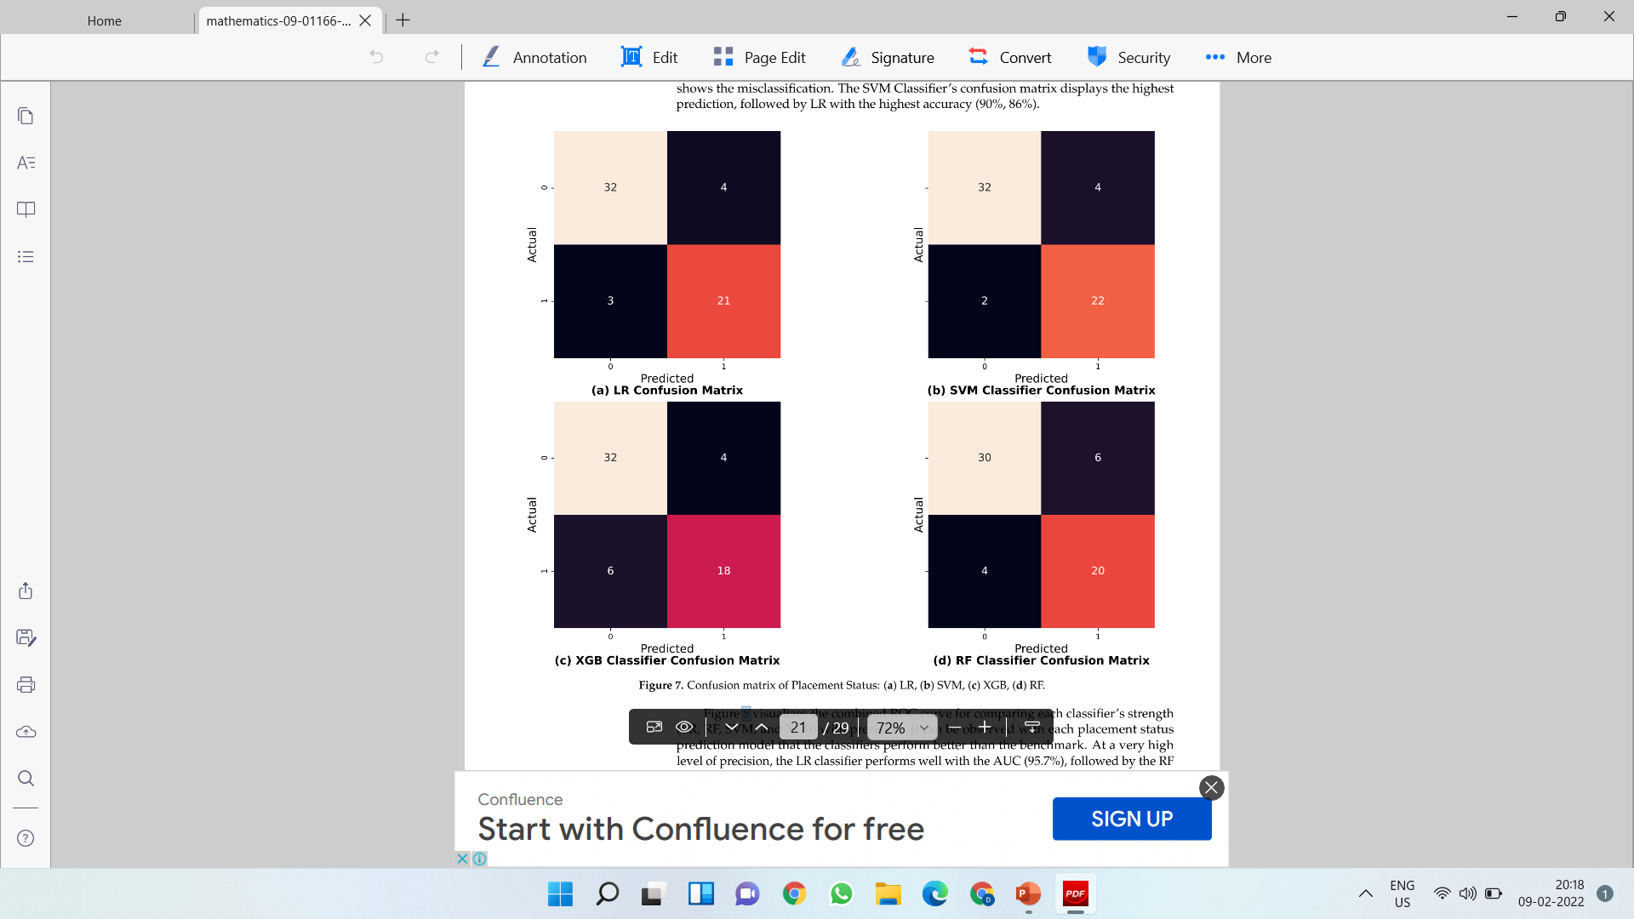

Slide 34
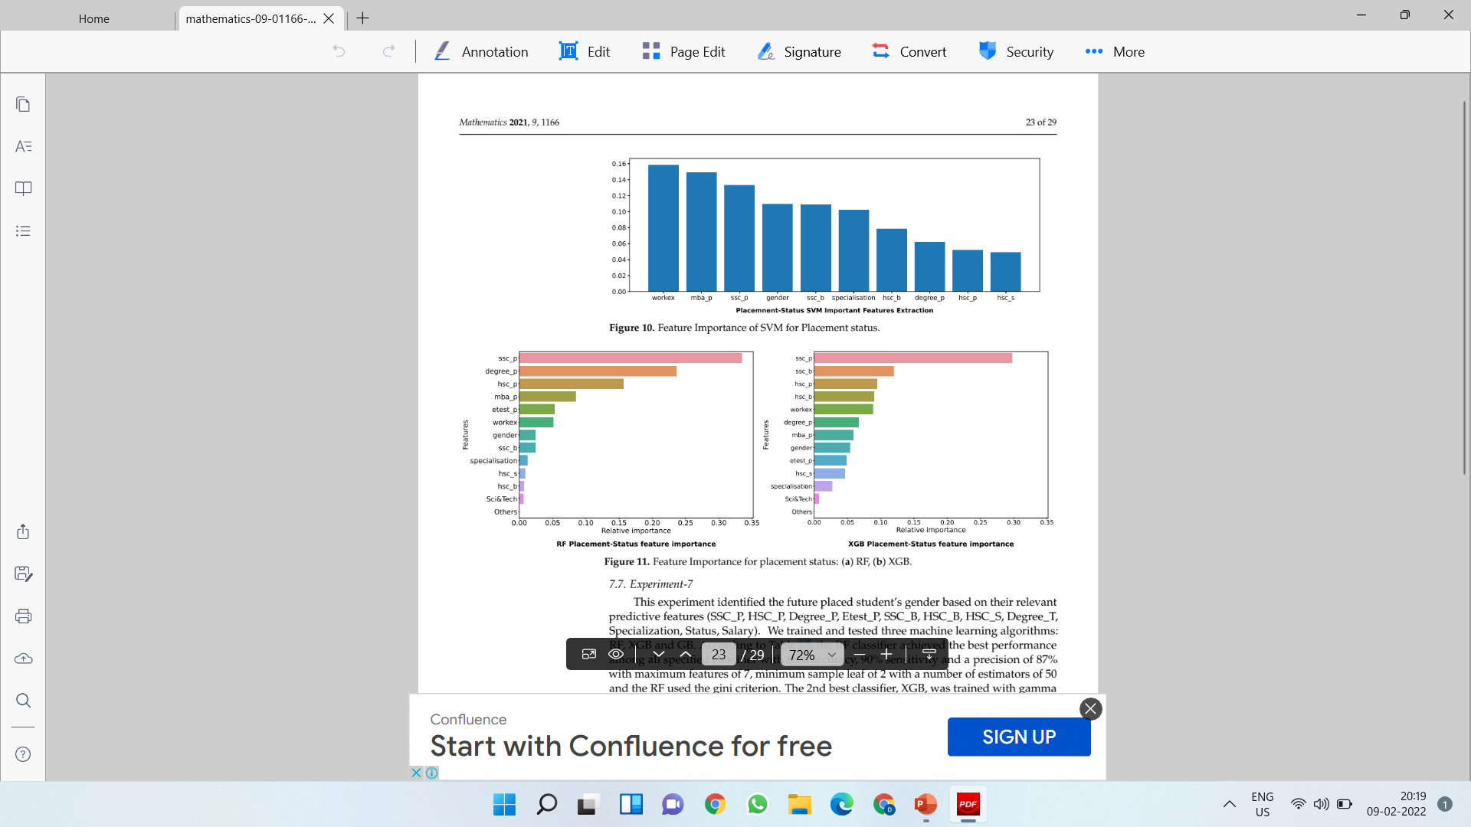

Slide 35
Discussion
In the statistical tests, the significant p-value is essential for judging the hypothesis.
To test the first three null hypotheses, a statistical t-test played a vital role. On the one hand, it explored the impact on offered salary of the student’s gender and MBA specialization. On the other hand, the placement test’s effect on gender was evaluated.
Further, an association test χ2 was applied to explore the relationship between placement status and degree stream and MBA specialization.
Later, in this study, we used the machine learning algorithms to automate predictive models to recognize the gender of placed students with its status.

Slide 36
It is found that the first null hypothesis, “H01: No Significant difference between male and female students towards Offered salary” failed to be rejected (p > 0.05).
It showed no statistically significant differences in the offered salary based on gender.
Hence, this study explored no impact of the offered salary on student’s gender. Based on this, the authors proposed its alternative hypothesis, “H01A: A Significant difference between male and female students towards Offered salary”, which it failed to accept.
The same scenario also happened in the case of the second and third null hypotheses: “H02: No Significant difference between Mkt&Fin and Mkt&HR towards offered salary” and “H03: No significant difference between male and female students towards placement test percentage”, which also failed to be rejected (p > 0.05).
Hence, it is found that the offered salary has no impact on the student’s specialization in their MBA study. Further, the student’s placement test percentage did not affect gender.
Therefore, the alternative hypotheses: “H02A: A Significant difference between Mkt&Fin and Mkt&HR towards offered salary” and “H03A: A significant difference between male and female students towards placement test percentage” were failed to be accepted.
Based on the first three hypotheses tests, no linear association was observed between student demographic features and offered salary and placement test percentage.

Slide 37
On the contrary, this study observed strange results from experiments that belonged to the association finding between MBA specialization and placement status.
The authors observed that the fourth null hypothesis, “H04: No association between Mkt&Fin and Mkt&HR specialization towards placement status” failed to be accepted (p < 0.05)”.
Therefore, specialization in a master’s degree impacted the placement of students. Alternately, the hypothesis, “H04A: A significant association between Mkt&Fin and Mkt&HR specialization towards placement status” failed to be rejected (p < 0.05).
Further, the fifth hypothesis, “H05: No association between stream of degree and placement status” failed to be rejected (p > 0.05).
Thus, the present work found a significant association of degree stream and placement status. For the present work, we proposed the alternative hypothesis, “H05A: A significant association between the stream of degree and placement status” with remarks “failed to accept”, which proved that the bachelor degree of streams (Sci&Tech, Comm&Mgmt, and others) have a correlation with students’ placements.
This work can also conclude that the bachelor’s degree streams did not have any impact on placement status.

Slide 38
The highest accuracy (90%) with features that also play a major role in the placement of students.
It was observed that work experience with the highest master’s degree percentage and SSC percentage are necessary for getting a placement.
The seventh objective for predicting the gender of a placed student with an RF model with the highest accuracy (88%).
The present paper unleashed thoughts on a real-time solution to assessing the impact of demographic features on placement and their offered salaries and to helping predict the placement status of given students’ academic percentage and other features with the extraction of important features in getting a placement.
It also predicted the gender of placement.

Slide 39
References
1. Sen, B.; Uçar, E.; Dele, D. Predicting and analyzing secondary education placement-test scores: A data mining approach. Expert Syst. ppl. 2012, 39, 9468–9476. [CrossRef]
2. Gallagher, A.M.; De Lisi, R. Gender differences in Scholastic Aptitude Test: Mathematics problem solving among high-ability students. J. Educ. Psychol. 1994, 86, 204–211. [CrossRef]
3. Roshan D.; Ben, K. Campus Placement. Available online: https://www.kaggle.com/benroshan/factors-affecting-campus placement (accessed on 19 December 2020).
4. Ojha, A.; Pattnaik, U.; Sankar S.R. Data analytics on placement data in a South Asian University. In Proceedings of the IEEE 2017 International Conference on Energy, Communication, Data Analytics and Soft Computing (ICECDS), Chennai, India, 1–2 August 2017; pp. 2413–2442.
5. Pruthi, K.A.; Bhatia, P. Application of Data Mining in predicting placement of students. In Proceedings of the IEEE 2015 International Conference on Green Computing and Internet of Things (ICGCIoT), Greater Noida, India, 8–10 October 2015; pp. 53–58.

Slide 40
Thanks
Contact:
Dr. Deepak Kumar
Email: dr.d.k.mehta81@gmail.com
Deepak.e11296@cumail.in
Orcid Id: https://orcid.org/0000-0001-5280-843X
Linked in: www.linkedin.com/in/dr-deepak-mehta-963838152

